Slide 1
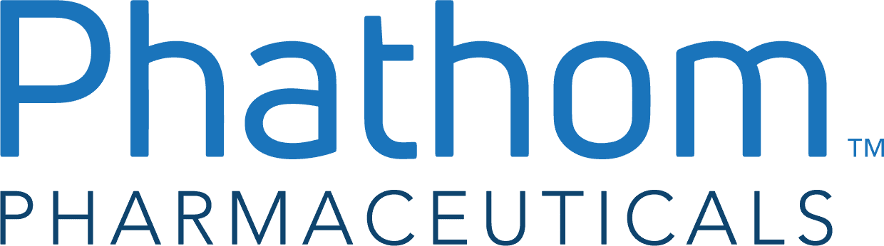
2025 HFAC x Citadel Stock Pitch Competition
LONG Phathom Pharmaceuticals
(NASDAQ: PHAT)
Pitched by: 2L Capital

Slide 2
Executive Summary
PHAT is a derisked clinical asset with a criminally underappreciated strategy pivot
Position: Long Current Px: $14.67 PT: $19.42 (+32% IRR) Horizon: 12mo R/R: 3.6x
Investment Theses
Drivers and Variance
GI-pivot has a larger, near-term runway that will drive higher top-line in the next 4Q’s as it ramps
Bear thesis is that mgmt. is overly optimistic on Gastrointestinal (GI) runway due to poor conversion of PPI-refractory patients to PCABs from non-acid incidence
  PHAT has not traded up since sales strategy change
This risk is overstated and offset by increased Rx adherence / refills
Sales force shift will be negligible to SG&A and revenue delay will be at the low-end of 1-3Q guidance
Street doubts feasibility of cutting OpEx and meaningfully growing revenue
  Q4 scripts are expected to be flat amid worry that shift has pushed out commercial viability (salient given LOEs in biotech)
We argue that GI propensity for PCABs will drive durable cost/time-savings
Why this opportunity exists
Why now?
Investors over indexing on unclear PPI-refractory penetration and sales force switching costs
Wait-and-see sentiment amidst slow sales ramp - PHAT needs to demonstrate uptake
Market pessimism in biotech depressing valuations
Clear key debate - will the recent pivot be profitable?
Unproven & new mgmt. with massive execution risks (debt)
Muddied % retail scripts data b/c of Medicare cash pay
Q3 beat & raise; PHAT DID NOT trade up due to low investor expectations for 4Q25 & 1Q26 top-line / Rx
Source: Company filings

Slide 3
Company Overview
Operator of orphan drug Vonoprazan in the US, Europe, and Canada
Company Overview
Owns the rights to distribute and commercialize vonoprazan (Voquezna, branded), a drug designed to treat stomach acid-related disorders; PHAT is predominantly a 1-drug company with a negligible pipeline in the near-term
Rights licensed from Takeda in 2019 after successful launch of the drug in Japan
Dual listings for chronic conditions (GERD/NERD) and contagious bacteria (H. Pylori) allow for 10-year exclusivity
Close to having net cash position, debt only comprises ~20% of EV, and company inflecting cash positive soon
Why did Takeda Out-License?
Financial Performance Since Launch
Management possibly expected 2028 patent expiry rather than current 2030+ leaving few years for exclusivity after testing, approval, and launch
SoC drug is metabolized by CYP2C19 enzyme, and in Asia 20% of patients have a deficient such enzyme that creates a clear value prop for differentiated MoA
Lack of proven viability (only 1 ex-Asia study in ’19)
Company Timeline
October 2019
IPO closes @ $24
April 2021
GERD endpoint success
November 2023
FDA approval for GERD
June 2025
10-year exclusivity confirmed
December 2019
H. Pylori & GERD studies begin
May 2022
H. Pylori formulation accepted
November 2024
Exclusivity period worries
Source: Company filings

Slide 4
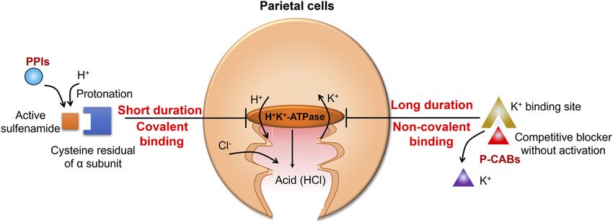
Understanding Voquezna Indications
GERD + H. Pylori comprise current labeled indications
Drivers and Variance
GERD Background
H. Pylori Background
Parietal cells in the stomach secrete acid when stimulated by taking potassium ions and producing hydrogen ions which combine with Cl-
GERD occurs when such acid flows into the esophagus on a repeated basis
  Symptoms include heartburn, chest pain, etc.
Can be significant detriment to QoL and often includes cancer / ulcer complications
  Similar symptoms but without the acid component is called functional heartburn
H. pylori is a bacteria that damages the stomach and small intestine causing inflammation and pain.
Bacteria multiplies while immune to stomach acid and eats into stomach tissue
Complications involve peptic ulcers and stomach cancer
Current SoC involves suppressing acid to increase antibiotic efficiency
US TAM Sizing
NERD
EE
H. Pylori Infection
Non-Erosive Reflux Disorder doesn’t lead to damage of the esophagus despite symptoms representing approx. 70% of the GERD umbrella
Erosive Esophagitis results in damage to esophageal cells causing irritation and swelling. Only diagnosable by endoscopy. 30% of GERD umbrella
~2mm
~45mm
~20mm
Management flags the US opportunity at upwards of $3bn
Source: Company filings, Company presentation

Slide 5

PCAB vs. PPIs
Understanding pharmacology differences & prescription pathways
Key MoA Differentiation
1
PPIs bond covalently to non-active site of the proton pump to denature the enzyme and prevent pumps from functioning, providing temporary 6–8 hour relief
1
2
2
PCABs are small oral molecules that bind to active site to compete with potassium ions to prevent pumps from producing hydrogen ions / stomach acid for 24 hours
Prescription Patterns
Quick Comparison
GERD / NERD patients typically either see primary care physicians (PCPs) or gastroenterologists (GIs) who prescribe PPIs as first-line therapy against typical GERD symptoms
Refractory patients (i.e. nonresponders) are sometimes given other PPI brands, but Voquezna is increasingly being used as the default second-line treatment
Patients with complex symptoms often referred by PCPs to GIs for chronic management
Studies indicate 30-40% of patients who go on PPI treatment are moderately or severely dissatisfied with relief
 |  | PPIs
Immediate Release | ✓
24-Hour Relief | ✓
Safety Profile | ✓ | ✓
Doses / Day | 1 | 2-3
Time Above pH4 | 80%+ | 40-70%
Avg. Monthly Price | ~$50 | ~$10
Source: Company filings, Company website

Slide 6
Setup / Story
Transient fears cloud potential for quality product step-function uplift
1
4
2
3
1
Bullish launch numbers heading into 2024; TRx IQVIA numbers promising and consensus SS projects accelerating uptake amid credible sales ramp
2
FDA orange book listing pins the GERD indication for Vonoprazan at only 5 years of exclusivity vs. anticipated 10 years and doesn’t indicate whether they will decide to consider extension.
3
FDA approves Citizen's Petition that extends LOE from 2027 to 2032 under the GAIN act, delaying onset of generics and extending runway for peak sales
4
Story has shifted towards whether / when new strategy targeting GIs (announced 2Q25 with updates in 3Q25 by new mgmt.) over PCPs will increase volume and sales
Source: Company filings, SS updates

Slide 7
Key Debate
It’s pretty simple…
Will PHAT’s sales strategy shift increase scripts volume over the NTM?
Will the shift grow the near-term runway?
Will the shift hit revenues in time & w/o new SG&A?

Slide 8
Key Debate
It’s pretty simple…
Will PHAT’s sales strategy shift increase scripts volume over the NTM?
Will the shift grow the near-term runway?
Will the shift hit revenues in time & w/o new SG&A?
Yes

Slide 9
1. GIs have greater runway to drive top-line growth
PHAT’s massive short interest is driven by concerns over actual runway
GIs are more efficient, which explain the sales shift rationale
Mgmt. shills the scripts productivity & runway | SS models 100% upside
Mgmt. sets the TAM at 20mm PPI scripts for GIs Thus, per mgmt., 20% penetration here would make Voquenza a blockbuster - in fact, mgmt. says they expect the product to be a blockbuster in GI alone PHAT observed a 4x return for the GI practices vs PCP practices for the same sales time This is despite 60-70% of sales effort spent on PCP Mgmt. argues higher ceiling for GI via PPI scripts | Upside is driven by “30-40%” PPI refractory rate which implies a TAM of “17-18mm” scripts - Cantor This implies that HDD% penetration into GI scripts will make Voquenza a blockbuster These patients also have higher refill rates Plus, GIs are more receptive to non-PPI MoAs When PPI a fails, 75% of GPs report they would switch to another PPI brand vs. 48% of GIs¹
This sounds like free money - but short interest is 24%. Why?
If you haven’t noticed, the upside is aggressive…the reason is clear - these TAMs are determined by the refractory rate
  The commonly cited 30-40% rate is symptomatically refractory² - meaning their symptoms aren’t helped by PPIs
  THIS IS INCLUDES NON-ACID TREATMENTS
Why? Because GERD is empirically treated before diagnosis, so if you have heartburn, you’ll be treated with PPI to test if you have GERD
  The “true” refractory rate is ~20%³ - since PPI refractory is ~99% of PHAT’s TAM, we know that almost all of SS upside is from the overstated TAM
In simpler terms, SS & mgmt. overstates TAM and cites a number that includes patients who don’t qualify for PCABs (because acid isn’t an issue); the real number is half that…and it’s no coincidence that current Px is likewise
So, why are we long?
Source: Company filings, (1) Carter & Dickman, 2018, (2) Cicala et al., 2013, (3) Halpern et al., 2010

Slide 10
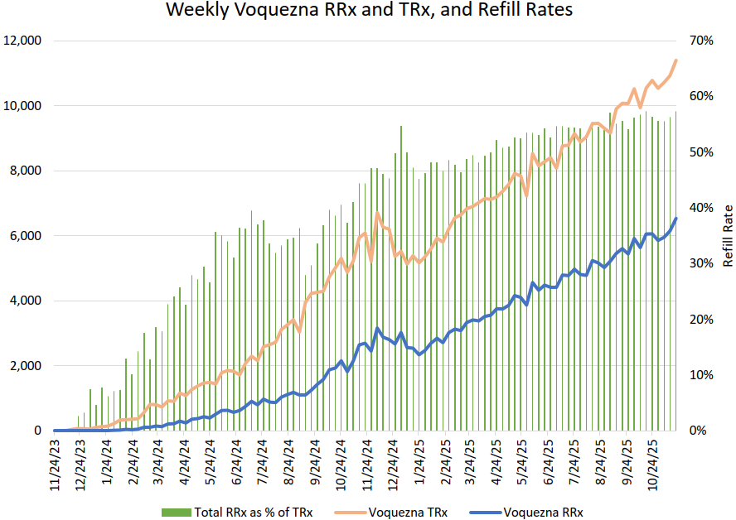
1. GIs have greater runway to drive top-line growth
Our runway driver is NOT TAM - greater refill rates from the shift are not priced in
The key runway driver is the refill rate
Via Needham’s Weekly Rx tracker, we see that for the consolidated biz, retail scripts have ~60% refill rate
  Per mgmt. this is closer to 70% (BlinkRx diff)
The trend is clear - refill rates are plateauing - thus, the main / only growth driver is TRx sales…right?
Cue the GI-pivot...
With the GI shift, the refill rate will once again inflect upwards, driving RRx and TRx (indirectly)
  Our work suggests that GI refill rates for Vonoprazan are in the 80-90% range
As GI’s get penetrated, refill rates will drive runway
What drives our conviction for 80-90% refill rates?
(i) PPI read throughs on severity & adherence | (ii) GI calls on procedural differentiation
US survey of ~2k GERD patients on PPIs showed 71% optimal use (correct timing) for GI scripts vs 47% for PCPs¹ GI patients are the chronic / more severe cases (see right) 16k person PPI persistence study showed a 27% 1yr persistence for symptomatic, 54% for A/B EE, & 73% for C/D EE² Thus, patients in the more GI-type cohort (C/D esophagitis) have meaningfully 1.5x-3.5x refill rates vs. PCP-type cohorts | GIs are more likely to scope patients prior to PCABs, thus less functional heartburn scripts “All my patients going on 20mg are scoped and most of the 10mg patients as well.” - GI, private practice As established prior, this implies higher refill rates Anecdotally, refill rates skews as high as 90%; we underwrite a more conservative ~80%
Source: Company transcripts, Company filings, Needham (IQVIA data), (1) Sheikh et al., 2014, (2) Van Soest et al., 2006

Slide 11
1. GIs have greater runway to drive top-line growth
Getting precise on our refill rate variance vs. market
What’s priced in - how reasonable are these assumptions?
We can back solve the key KPI assumptions in the share px
  The current $15 px implies a 70% refill rate, 25% peak 2L market penetration, & 55% GTN discount (see appx.)
25% penetration slots into mgmt.’s 20-30% range, & 55% discount is in-line with the last 2 fiscal years
  This conservatively does not assume increases in % IQIVIA/BlinkRx scripts, nor decreases in GTN discount
So, what drives our variance? Why now?
Variance to the bears
Why hasn’t this refill rate inflection hit yet? Hasn’t it been happening for the last Q?
Yes, but (i) sales takes time to convert the GIs & APPs (ii) BlinkRx refills are first counted as a new Rx (as they were not in the IQVIA system beforehand), before converting to RRx (which is also why true refill rate > IQVIA rate). Thus, this timing has obfuscated the benefits of the switch insofar.
We model an 80% refill rates on a going forward basis. This bumps peak sales from our est. 800mm (where the current px implies) to 950mm
  We believe we are in-line with bear TAM estimates
Variance to SS / consensus
 | Cantor | Evercore | Jefferies | Needham | Goldman | Ours
%PPI refractory | 30% | 35% | 35% | 25% | 24% | 20%
GTN discount | 50% | 25% | 60% | 35% | 60% | 55%
Compliance | 95% | n/a | 50% | 75% | 50% | 80%
By in-large, SS either has obtusely high refractory rates / low gross-to-net discounts
GS conservatively models KPIs, but overstates % of patients on GERD treatments
  TAM of patients on GERD treatments is ~ 22mm; GS models 55mm
Source: Company transcripts, Company filings, SS initiations / model updates

Slide 12
2. Sales productivity will drive scripts vol. w/ less cost
Less sales time / script = little revenue delay from sales force switch
Investors doubt execution timeline / success
Investors are doubtthe economics of this switch
  How can PHAT reduce Opex, yet grow revenue and scripts volume?
  How can PHAT have little revenue delay?
Simple. The old, DTC strategy was flawed
“To go deeper within GIs…it could take 1 or 2 or 3 quarters to really start to pay off” - CEO, Jun ’25
“We await…for additional validation of the company’s revised strategy…[and] execution on cost reduction front” - GS, Oct ’25
Old, DTC-based strategy succeeded in Japan… | … and US GIs are the equivalent to JP PCPs
Vonoprazan (marketed as Takecab) was the default 1L treatment for H. Pylori and acid related disorders High-volume reflux patients stay within primary care, making PCPs the key PPI leverage point | 2L in the US, BUT most GERD patients in for GI’s already qualify for 2L treatment GERD and PPI failures are disproportionately managed by GIs in the US
Generics had 60% mkt. share in 2015 upon introduction, but Takecab became most prescribed drug in a 5-year span
Sales directly to most severe chronic PPI patients proven to be most effective strategy
Takecab revenues in Japan almost $800mm despite 1/4th the prevalence of the US and 1/3rd the population
There is inherently a delay for these conversions to hit IQVIA data – earliest pickup likely in 1Q26
1) Sales force geographic reshuffling and 2) hiring ~10% new reps likely to create temporary one-quarter headwind as relationships are required to be reestablished; BlinkRx (from new scripts) further delay by 30d
Source: Company filings, Company transcripts, SS updates

Slide 13
2. Sales productivity will drive scripts vol. w/ less cost
We believe the pickup will be fast with little execution risk
Three Key Levers Drive Our Conviction
1) GIs are more familiar with the drug and surrounding scientific literature vs. less familiar PCPs
SS Survey (n=29) shows 88% of GIs very familiar with drug vs. ~20% of PCPs meaning sales reps have much easier job selling
We have heard nurse practitioners in primary care (now 47% of all primary care clinicians!) tend to stick with known drugs
2) Ten-year history in Japan & simple MoA offers unique and optimal safety profile for recent launch
Japan launch has allowed for longitudinal / longer-term studies
Studies even show vonoprazan is safer than PPIs w/ 32.7% adverse events vs. 40.5% PPI
GIs disproportionally rate safety as important to prescribing vs. PCPs²
3) Greater willingness to use novel MoA PCABs for chronic PPI refractory patients
GIs 2x more likely than PCPs to stop PPIs in non-responders¹
After multiple PPI failures, more GIs opt to investigate alternate therapy mechanisms vs. PCPs who are likely to continue PPIs²
  27% of PPIs vs. ~50% of GIs would consider non-PPI therapy
Our proprietary calls to GIs have echoed these drivers; we have heard that the timeline between outreach and prescribing ramp is < 1 month.
We even called a GI who had not heard of the Voquezna because sales reps were not allowed at his university system, and he immediately told us that he would look into prescribing it because of the MoA advantages
PHAT’s top prescribers are just ~1.5k GIs with a total of ~24k available to target – we believe there is significant untapped runway here.
PPIs are on 30/60/90 day scripts meaning GIs will see meaningful share of PPI refractory patients in the next 1-2 quarters
Source: Company filings, (1) Armstrong et al., 2022, (2) Carter & Dickman, 2018

Slide 14
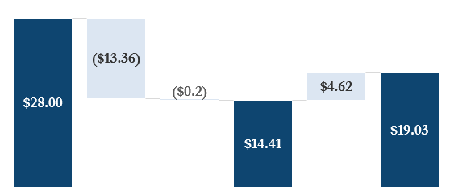
Payoff Structure
Returns reveal asymmetric returns driven by refill rates with capped downside per conservative estimates
20% refra-ctory rate
*Adjustments
80% refill rate
Median SS PT
Current Px
Our PT
Black swan bear case
-5% refill rate
-3% 2L GERD penetration
-9% downside
3.6x R/R
+
=
GI-pivot only marginal in increasing refills
GIs have capped penetration
vs. Base case
Both factors extremely unlikely as empirical evidence points to even higher refill rates (up to 90%) and greater penetration (up to 30%)
Source: Company filings

Slide 15
Event Path / Pre-Mortem
4Q25
1H26
3Q26
Positive scripts data
IQVIA tracker shows consolidated refill re-inflected to high 60s
Higher TRx share from GIs and APPs
Mgmt. guidance does not accrete SG&A / opex w.o new restructuring charges
GI focus accreting to top-line
With 2-3Q of GI focus, street should see clear step up in TRx growth and RRx/TRx mix
  Expect refill rates moving towards low 70s
Revenue up sharply y/y as GTN discounts do not crash and sales force spend flat to slightly down
SI compresses as TAM concerns and opex fears begin unwinding
Profits
First profitable quarter with credible path to FY26 profitability
Consolidated refills should now be high 70s
Mgmt. can credibly discuss DTC 2.0 as execution risks have largely passed
Risks | Mitigants | Commentary
GI shift will cannibalize PPI cohorts | Early GI usage is disproportionately PPI-refractory cohorts | GIs already account for ~70% of scripts anyways + model does not rely on incremental GERD incidence
New entrant into PCAB space | FDA exclusivity against generic competition + extended into 2034 | Patents for ODT and OTC versions provide an extra 3yrs of market protection
Execution issues given massive debt burden | PHAT still has undrawn ATM and term-loan capacity | Mgmt. has already cut Opex ~50% and is guiding to profitability in 2026. We do note that this is probably the largest risk, though offset by scripts strength
Payer / GTN pressures keep net pricing low | Commercial access already 80%+ of lives with cash-pay programs mature | No view on this on the model. though we conservatively set a fixed 55% discount throughout (though GI shift would likely reduce discount)
Source: Company filings, Company transcripts
15

Slide 16
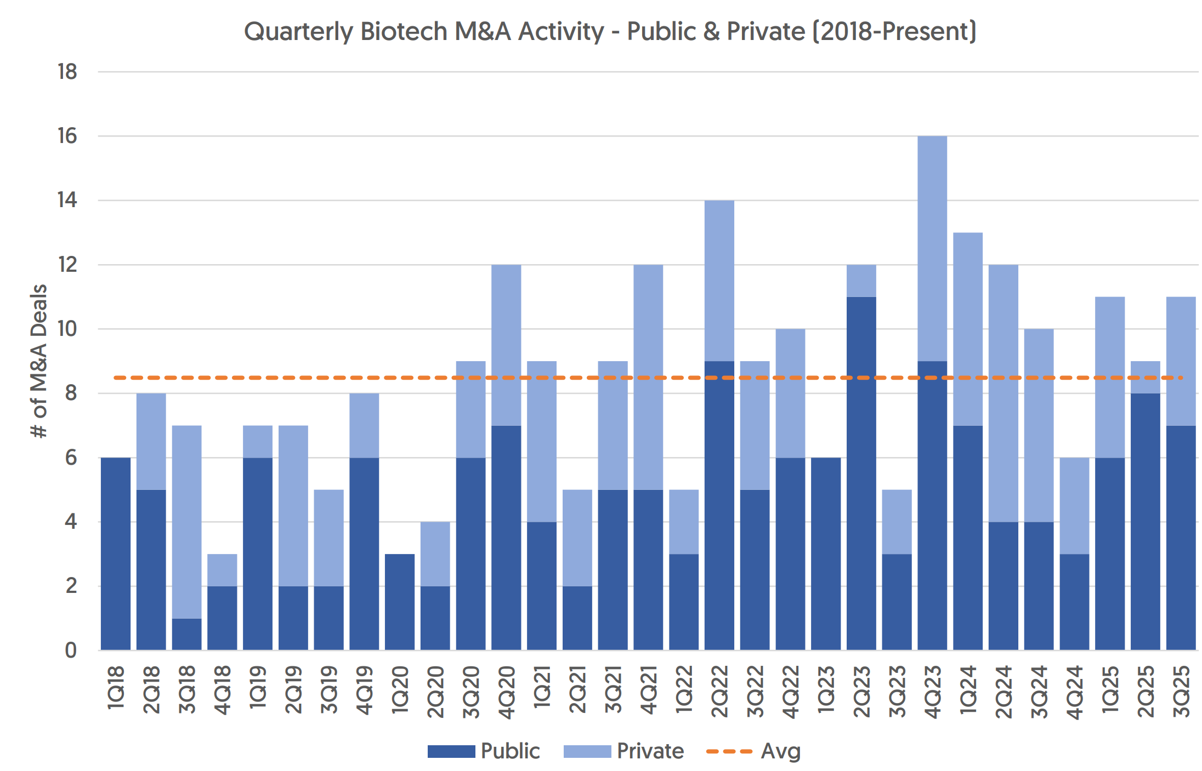
Free Call Options - “Known Unknowns”
1) Non-zero acquisition probability
PHAT is an ideal target… | … as the landscape picks up
Needham note on October 10th flagged PHAT as one of the most likely companies in coverage to be acquired Commercial/market stage of drugs make the most attractive targets (esp. as the 2030 LOE wall comes up): “Of the 155 public company acquisitions since 2018, ~72% were in at least Ph3 stage of development: 44% had a marketed drug, 7% had a drug under regulatory review, and 21% had their lead program in Phase 3 development.” | Activity up slightly QoQ and YoY Also seeing increase in % of acquisitions w/ market drug as a proof point
2) Bearish sentiment means any incremental positive payor news is accretive
Our calls validate that largest barrier to prescribing Voquezna is that insurance is a pain to deal with – BlinkRx helpful but patients still see meaningful delta between $50 / month PCAB and $10 / month PPI
Voquezna scripts sap time if filed through insurance as proof is needed for multiple PPI failures
Japanese studies indicate PCABs actually cost less in long-run as less treatments / medical episodes occur which may incentive payor adoption¹
Management continues to work with Medicare to expand coverage (>80% current)
Any positive news in the NTM sends stock higher
BUT…
3) Ongoing trials promising & would expand TAM
Successful Ph2 “as-needed” NERD study supports Ph3 program for OTC-like episodic-use market on top of chronic daily users
Just started Ph2 trial in EoE (eosinophilic esophagitis); EoE is an under-served indication where PPIs are commonly used off-label and only 2 drugs are approved
Additional call options with potential OTC switch, new formulations (ODT / IV), and ex-US partnerships (EU / Canada)
Source: Company filings, SS updates (1) Habu 2019

Slide 17
Appendix

Slide 18
Valuation: Revenue build
We used a top down market build to estimate EE, NERD, and H. Pylori sales; estimates were backsolved via IQVIA data to either be overly conservative or in-line with prior Rx data
  EE mkt assumed 30% of GERD, from which 35% on EE treatment, 80% of those on PPIs, and 20% refractory
  NERD assumed 60% of GERD, from which 35% on treatment, 68% on PPIs, and 20% refractory
Penetration rates between NERD and EE were assumed to be roughly equal, as while Vonoprazan is technically superior for more severe (e.g. EE), there is significant demand for the on-demand dosing of PCABs
  H. Pylori was not significant to revenues

Slide 19
Valuation: Base case

Slide 20
Valuation: 70% refill rate implied px

Slide 21
Valuation: DCF

